Slide 1
A Program for visitors map
(in the city of Bangalore,India)

Slide 2
Introduction
AGD travels is a company based in bangalore which provides digital maps for visitors which conatins information about the several neighbourhoods of the city. the information contains places to get food(including restaurants, cafes, hookah bars, bars ,etc.),landscapes, recreation spots, police stations and hospitals(for emergency). They also provide a cluster map which shows the neighbourhoods with similar food locations for customers with a knack of food blogging

Slide 3
DATA DESCRIPTION
The preliminary dataset is made from web scraping from a wikipedia page(https://en.wikipedia.org/wiki/List_of_neighbourhoods_in_Bangalore). The location coordinates are searched using the geopy library of the python language. The data used in this project is provided by Foursquare location data. Specific API calls are made for specific types of category. The category Id is used to get the various categorical venues. The data are grouped by neighbourhood areas, and each area includes the information about restaurants, cafes, landscapes, recreation spots, police stations and hospitals present in those area.

Slide 4
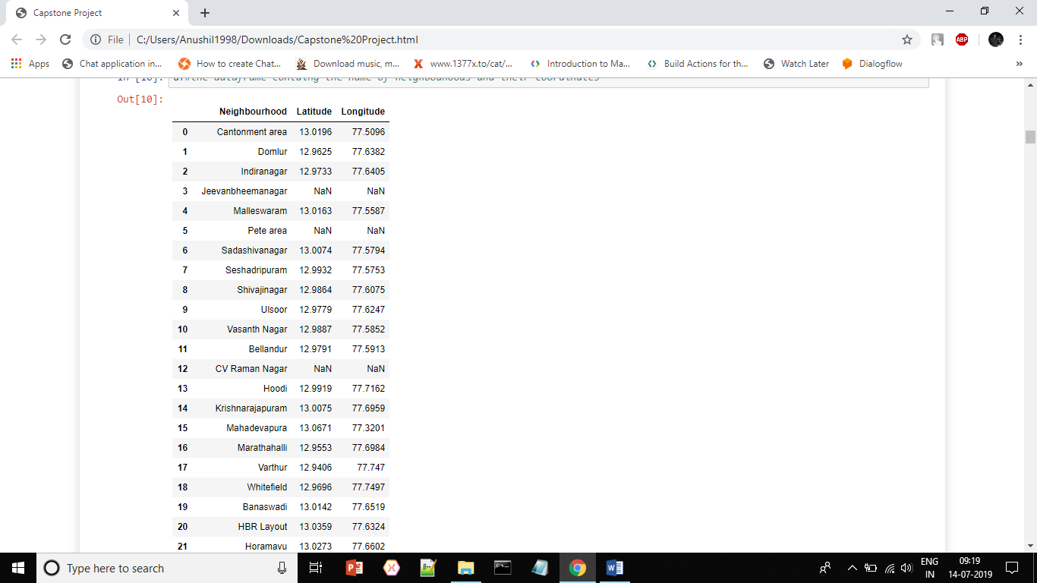
Priliminary Dataset

Slide 5
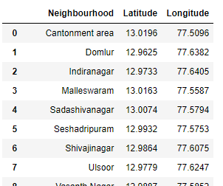
Methodology
Cleaning:
Missing data is removed and then the data set looks like this:

Slide 6
Getting Data
The data of the nearby locations( restauraunts, cafés, food joints, hospitals etc.) are received using the foursquare API calls.
Here the lat ,lng are the coordinates(latitude and longitude respectively) of the neighbourhoods. The Radius is the measure of the search radius which in this case is 500 and can be altered for more detailed mapping.
The categoryID is the most important as it decide the category of the venues this API call returns.
url = 'https://api.foursquare.com/v2/venues/explore?&client_id={}&client_secret={}&v={}&ll={},{}&radius={}&limit={}&categoryId={}‘
.format( CLIENT_ID, CLIENT_SECRET, VERSION, lat, lng, radius, LIMIT,categoryID)

Slide 7
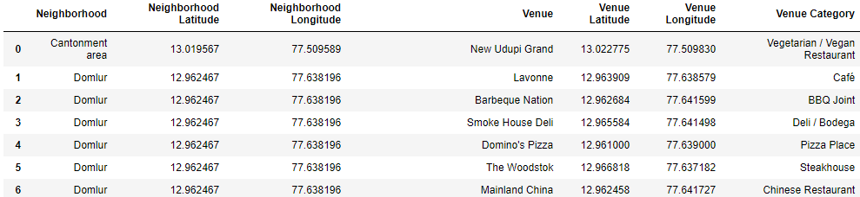
Datasets
The data set looks like:
The fields are :
1. Name of neighbourhoods: Neighborhood.
2. The Latitude of the Neighbourhood: Neighborhood Latitude
3. The Longitude of the Neighborhood: Neighborhood Longitude
4. The Name of the Venue: Venue
5. The Latitude of the Venue: Venue Latitude
6. The Longitude of the Venue: Venue Longitude
7. The Venue Category: Venue Category

Slide 8
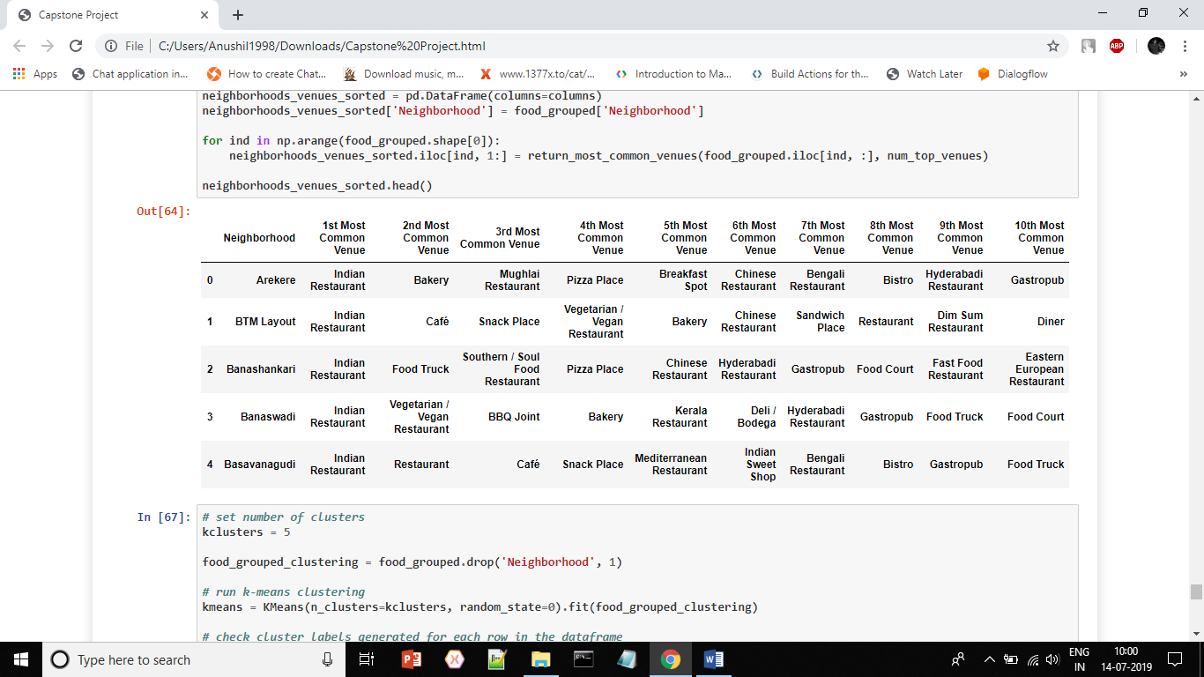
Clustering of Food related Places
This section is specific to visitors who are food bloggers or in general foodies.
The neighbourhood is divided into clusters according to the top 10 common types of food venues in them.
The data set is created for that purpose

Slide 9
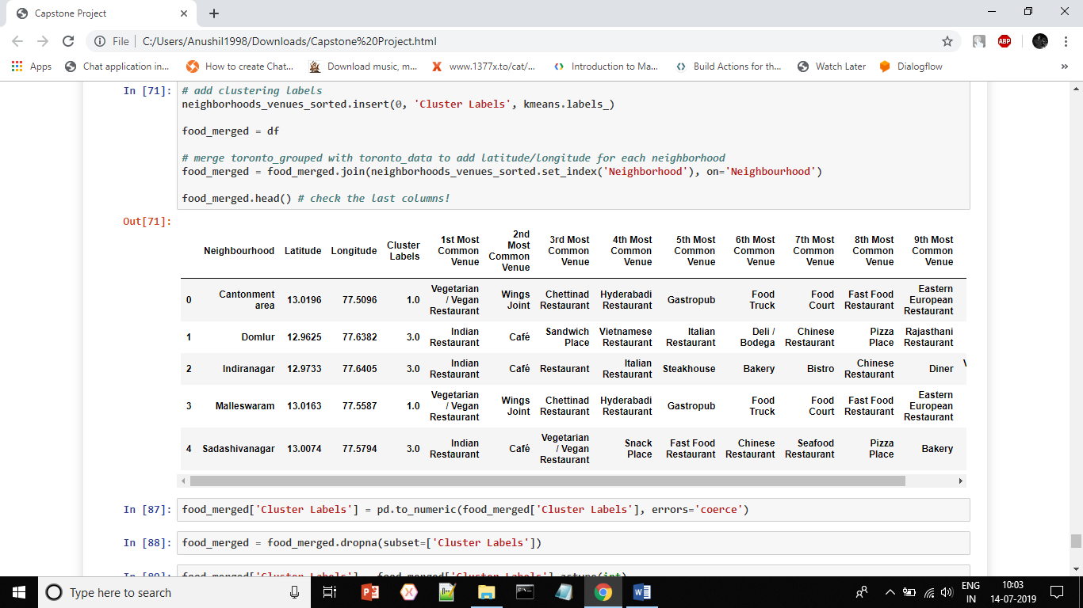
Cluster dataset (with cluster labels)
The cluster labels indicate the cluster to which each neighbourhood belongs

Slide 10
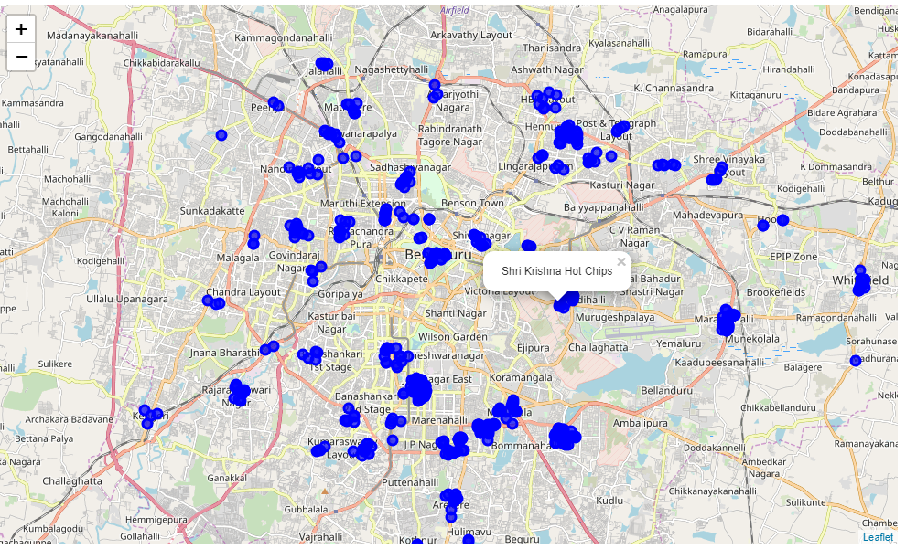
Results
Map1: This map represents the restaurants, cafés and other food related areas

Slide 11
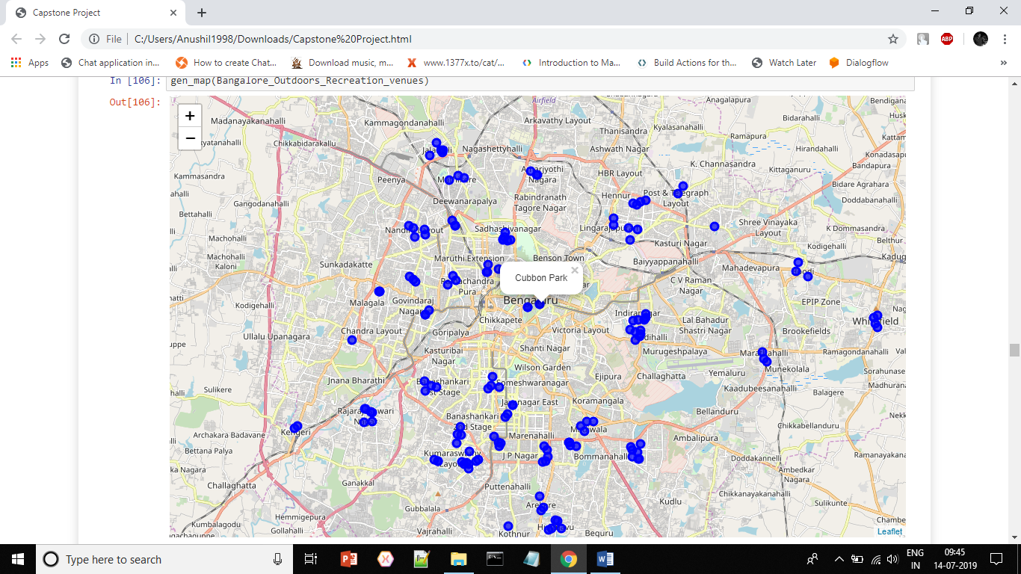
Map2: This shows the Outdoor recreational places.

Slide 12
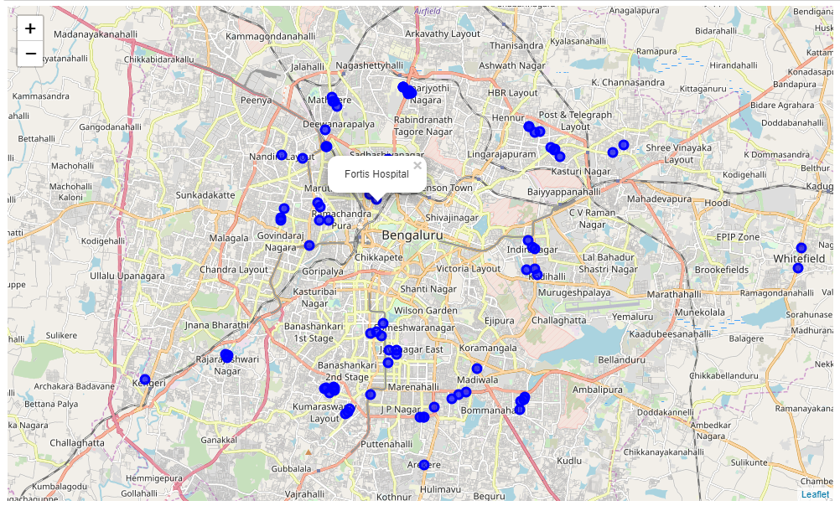
Map3: This shows the hospitals and other health care facilities in the city

Slide 13
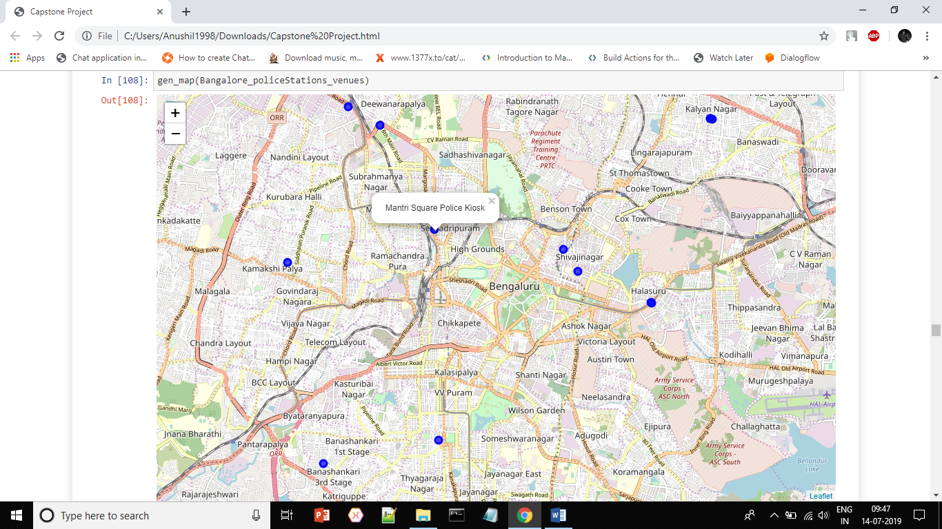
Map4: This shows the locations of the various police stations and plice help desk for emergency situations.

Slide 14
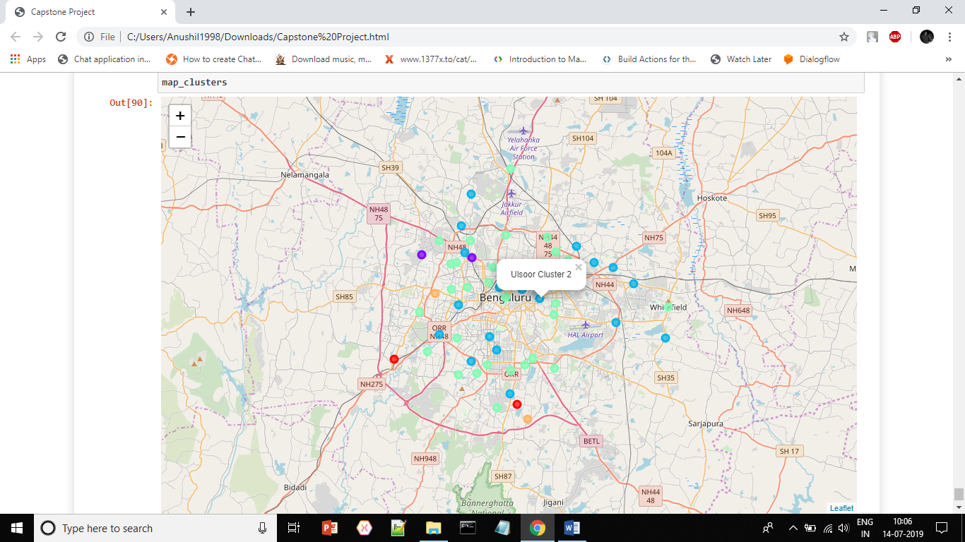
Map5: This is the cluster map which shows the neighbourhoods and are coloured in the colours of their respective clusters. The neighbourhood of the same colour have similar food locations.

Slide 15
Discussions
Now the visitors will be able to plan their visits according to various food locations in the city.
The last map in the result section is mainly for food eccentric visitors.
The clustering is based on top 10 restaurants of the location this can be changed for futher clustering.The number of venues can be increased/decreased using the radius variable in API calls .
The cluster is helping for people to identify similar places and not waste time in places similar kind f which they have already visited.

Slide 16
Conclusion
This map is a great help to visitors (especially food eccentric visitors to the place). Bangalore is a city of people from several places and Backgrounds and it has something to offer to everyone.

